Slide 1

Math's 4
More shapes….

Slide 2
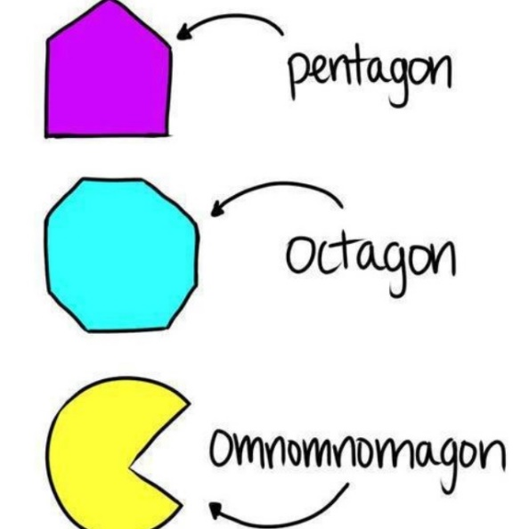
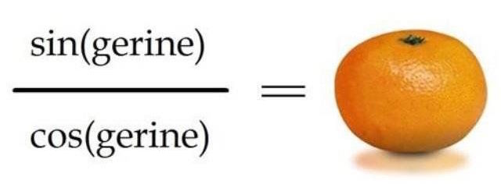
More Shapes
Sorry…

Slide 3
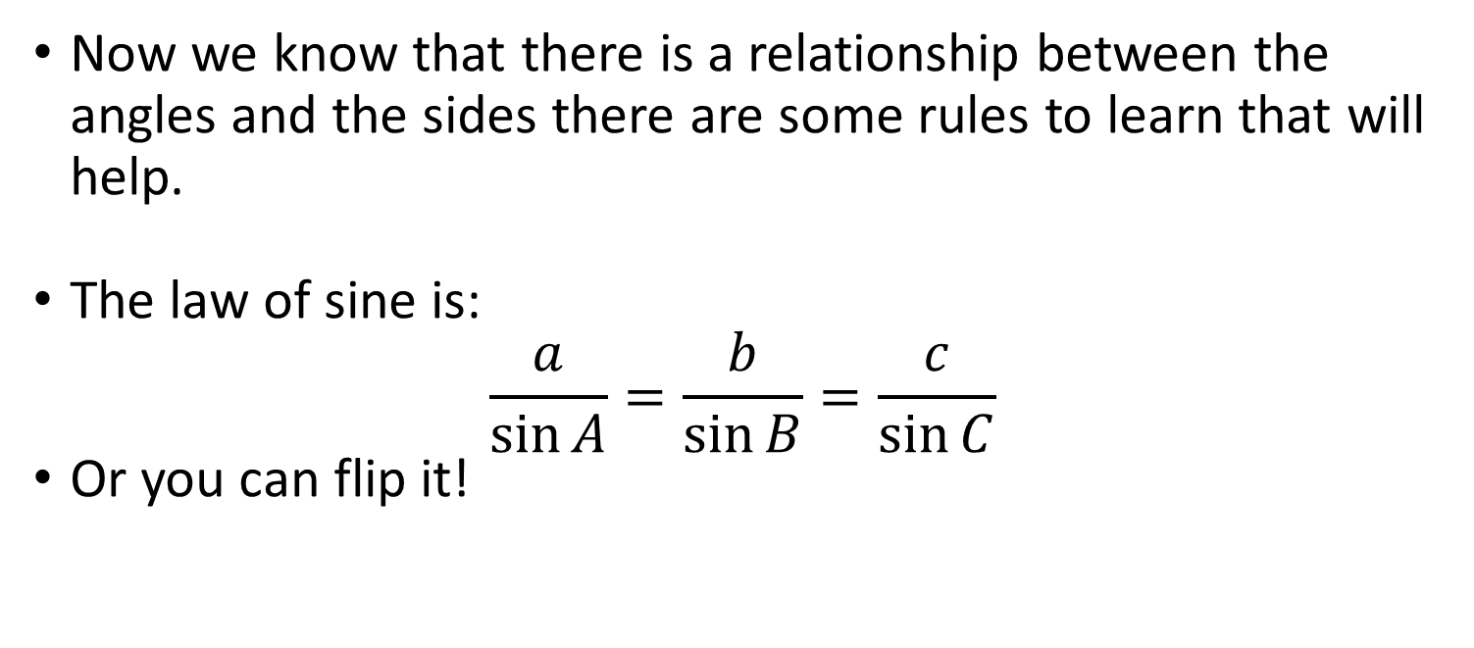
The Sine Law
Now we know that there is a relationship between the angles and the sides there are some rules to learn that will help.
The law of sine is:
$$\frac{a}{\sin{A}}=\frac{b}{\sin{B}}=\frac{c}{\sin{C}}$$
Or you can flip it!

Slide 4

The Sine Law
The law of sine is:
$$\frac{a}{\sin{A}}=\frac{b}{\sin{B}}=\frac{c}{\sin{C}}$$
Where:
B
c
a
A
C
b

Slide 5
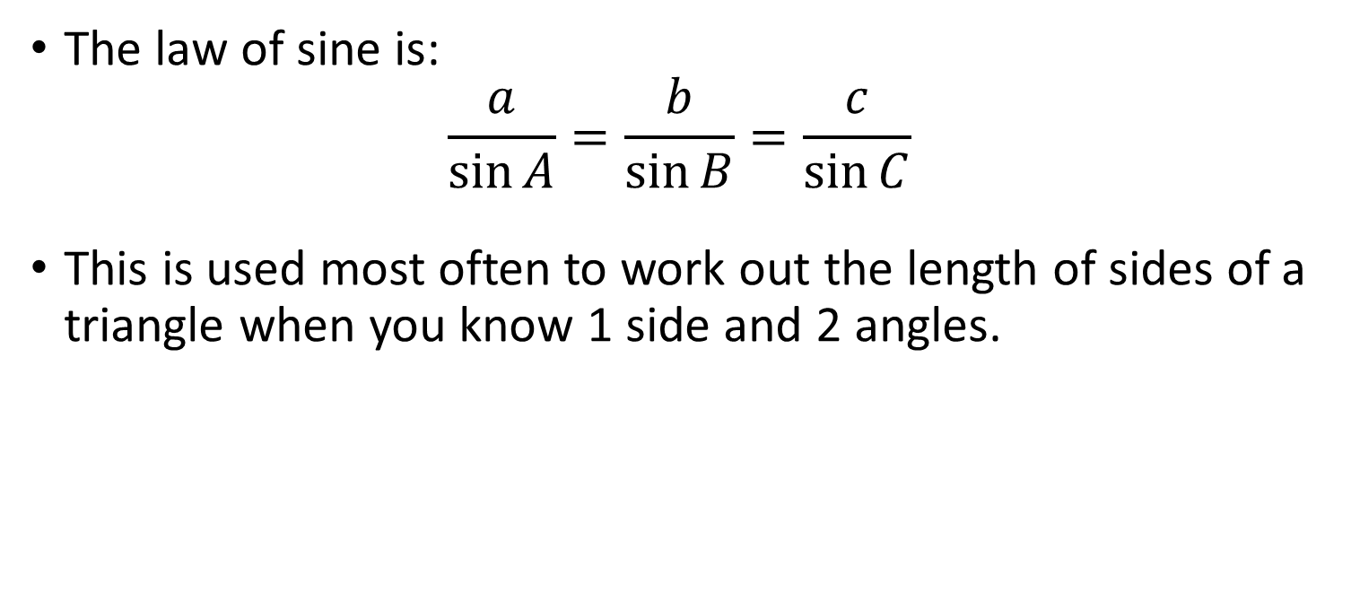
The Sine Law
The law of sine is:
$$\frac{a}{\sin{A}}=\frac{b}{\sin{B}}=\frac{c}{\sin{C}}$$
This is used most often to work out the length of sides of a triangle when you know 1 side and 2 angles.
B
c
a
A
C
b

Slide 6
The Sine Law
The law of sine is:
$$\frac{a}{\sin{A}}=\frac{b}{\sin{B}}=\frac{c}{\sin{C}}$$
This is used most often to work out the length of sides of a triangle when you know 1 side and 2 angles.
B
c
a
A
C
b

Slide 7

The Sine Law
The law of sine is:
$$\frac{a}{\sin{A}}=\frac{b}{\sin{B}}=\frac{c}{\sin{C}}$$
This can be applied to non right angled triangles.
B
c
a
A
C
b

Slide 8

The Sine Law
Lets try:
$$\frac{a}{\sin{A}}=\frac{b}{\sin{B}}=\frac{c}{\sin{C}}$$
B
c
a
A
C
b

Slide 9
The Sine Law
Lets try:
$$\frac{a}{\sin{A}}=\frac{b}{\sin{B}}=\frac{c}{\sin{C}}$$
39
c
a
27
C
14

Slide 10

The Sine Law
Lets try:
$$\frac{a}{\sin{27}}=\frac{14}{\sin{39}}=\frac{c}{\sin{C}}$$
39
c
a
27
C
14

Slide 11
The Sine Law
Lets try:
$$\frac{a}{\sin{27}}=\frac{14}{\sin{39}}=\frac{c}{\sin{C}}$$
39
c
a
27
C
14

Slide 12

The Sine Law
Lets try:
$$a =\frac{14}{\sin{39}} ∗\sin{27}=$$
39
c
a
27
C
14

Slide 13

The Sine Law
Lets try:
$$a =22.22 ∗\sin{27}=$$
39
c
a
27
C
14

Slide 14

The Sine Law
Lets try:
$$a =10.09$$
39
c
a
27
C
14

Slide 15

The Cosine Law
There is a second law of used for working out angles or lengths in non right angled triangles.
$c^{2}=a^{2}+b^{2} −2ab\cos{γ}$
Where:
c
a
γ
b

Slide 16
The Cosine Law
There is a second law of used for working out angles or lengths in non right angled triangles.
$c^{2}=a^{2}+b^{2} −2ab\cos{γ}$
Where:
c
a
γ
b

Slide 17

The Cosine Law
This law is Pythagoras but applied to all triangles.
$c^{2}=a^{2}+b^{2} −2ab\cos{γ}$
Where:
c
a
γ
b

Slide 18

The Cosine Law
Lets try
$c^{2}=a^{2}+b^{2} −2ab\cos{γ}$
Where:
c
12
51
17

Slide 19

The Cosine Law
Lets try
$c^{2}={17}^{2}+{12}^{2} −2∗17 ∗12\cos{51}$
Where:
c
12
51
17

Slide 20

The Cosine Law
Lets try
$c^{2}=289+144 −408 ∗0.6293$
Where:
c
12
51
17

Slide 21

The Cosine Law
Lets try
$c^{2}=433 −256.7627$
Where:
c
12
51
17

Slide 22
The Cosine Law
Lets try
$c^{2}=433 −256.7627$
Where:
c
12
51
17

Slide 23

The Cosine Law
Lets try
$$c=√176.2373$$
Where:
c
12
51
17

Slide 24

The Cosine Law
Lets try
$$c=13.27$$
c
12
51
17

Slide 25
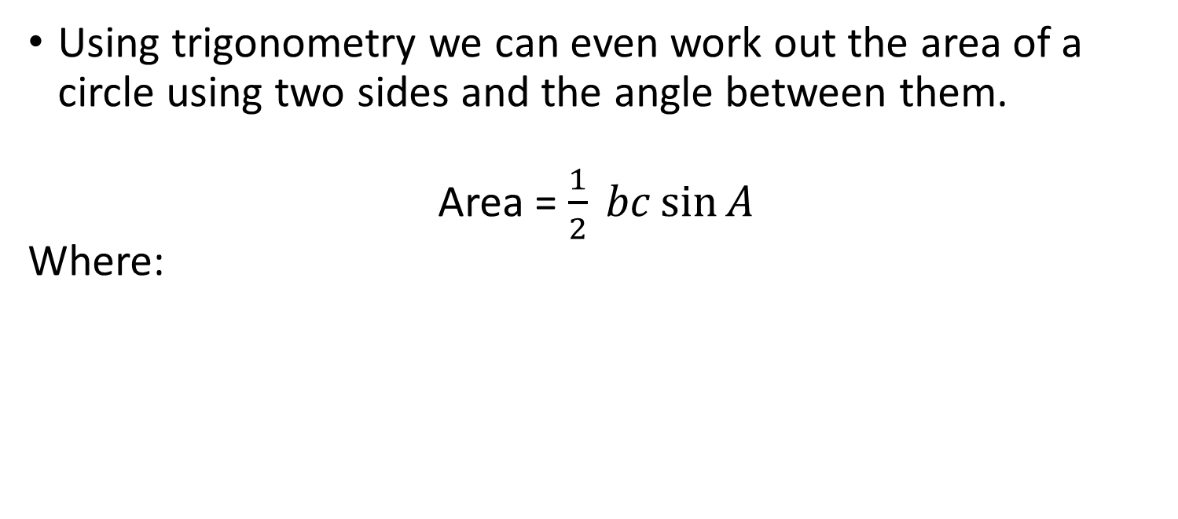
Area of a Triangle
Using trigonometry we can even work out the area of a circle using two sides and the angle between them.
Area = $\frac{1}{2} bc\sin{A}$
Where:
c
a
A
b

Slide 26

Area of a Triangle
Area = $\frac{1}{2} bc\sin{A}$
Where:
21
a
42
17

Slide 27

Area of a Triangle
Area = $\frac{1}{2} 17 ∗21 ∗\sin{42}$
Where:
21
a
42
17

Slide 28

Area of a Triangle
Area = $\frac{1}{2} 357∗0.6691$
Where:
21
a
42
17

Slide 29

Area of a Triangle
Area = $\frac{1}{2} 238.8796$
Where:
21
a
42
17

Slide 30

Area of a Triangle
Area = $119.45$
21
a
42
17

Slide 31
Solutions of Triangles
Using all the rules we have covered before with a combination of known measurements we can get all the other measurements of a triangle.
To do this you simply look at the kind of triangle it is, what measurements you have and remember your rules.

Slide 32
Solutions of Triangles
Using all the rules we have covered before with a combination of known measurements we can get all the other measurements of a triangle.
To do this you simply look at the kind of triangle it is, what measurements you have and remember your rules.

Slide 33
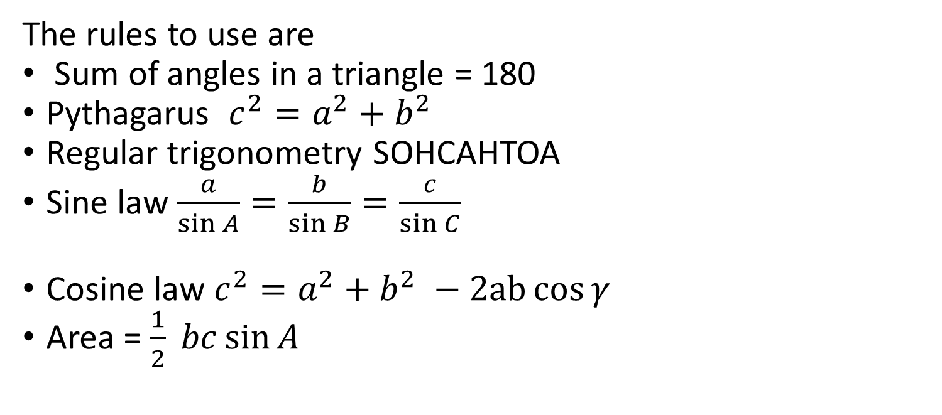
Solutions of Triangles
The rules to use are
Sum of angles in a triangle = 180
Pythagarus $c^{2}=a^{2}+b^{2}$
Regular trigonometry SOHCAHTOA
Sine law $\frac{a}{\sin{A}}=\frac{b}{\sin{B}}=\frac{c}{\sin{C}}$
Cosine law $c^{2}=a^{2}+b^{2} −2ab\cos{γ}$
Area = $\frac{1}{2} bc\sin{A}$

Slide 34
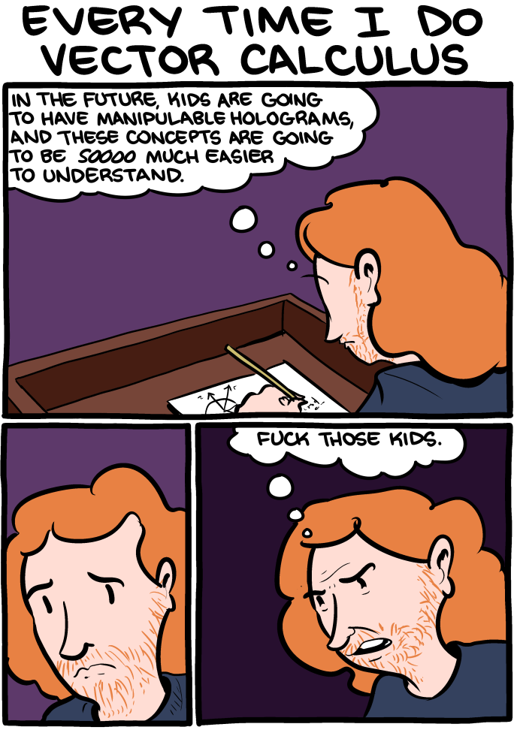
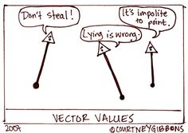
Vectors

Slide 35
Vectors
A vector simply is a description of movement from one position to another
It has both a direction and a magnitude (length).
It is denoted by line with an arrow in the middle

Slide 36
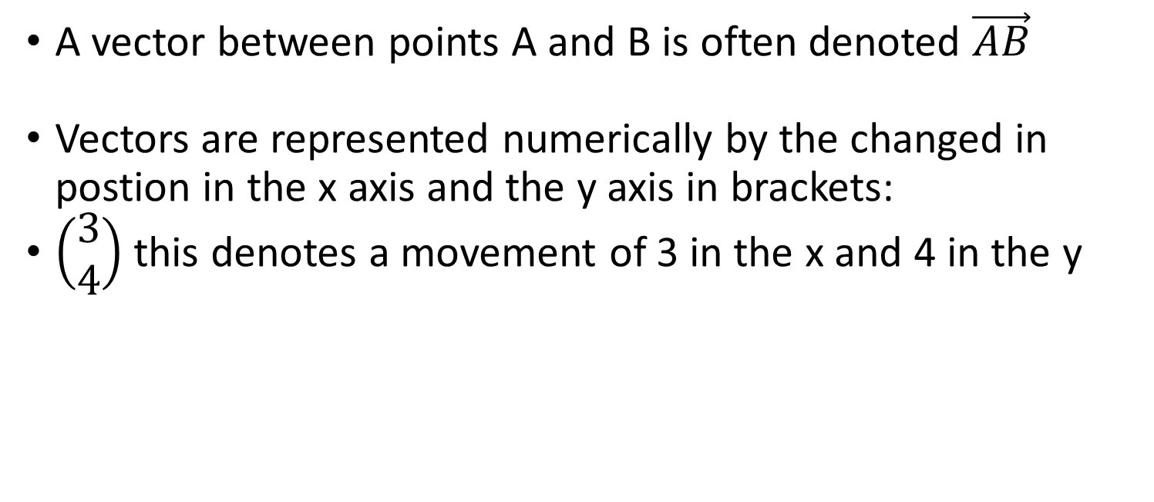
Vectors
A vector between points A and B is often denoted $\vec{AB}$
Vectors are represented numerically by the changed in postion in the x axis and the y axis in brackets:
$\left(\begin{aligned}3 \\ 4\end{aligned}\right)$ this denotes a movement of 3 in the x and 4 in the y

Slide 37

Vectors
$\left(\begin{aligned}3 \\ 4\end{aligned}\right)$ this denotes a movement of 3 in the x and 4 in the y

Slide 38
Vectors
vectors can have shared magnitude and direction and a called equal.

Slide 39
Vectors
If vectors are equal and opposite one is the negative of the other.

Slide 40
Vectors
Vectors can be multiplied by a scalar which increases size but not direction
a
2a

Slide 41



Vectors
You can combine vectors by adding them creating a resultant vector.
$$\vec{BC}$$
$$\vec{AB}$$
$$\vec{AC}$$

Slide 42

Vectors
You can combine vectors by adding them creating a resultant vector.
$\left(\begin{aligned}2 \\ 2\end{aligned}\right)$ + $\left(\begin{aligned}2.5 \\ −1.75\end{aligned}\right)$
$$\vec{BC}$$
$$\vec{AB}$$
$$\vec{AC}$$

Slide 43

Vectors
You can combine vectors by adding them creating a resultant vector.
$\left(\begin{aligned}4.5 \\ 0.25\end{aligned}\right)$
$$\vec{BC}$$
$$\vec{AB}$$
$$\vec{AC}$$

Slide 44



Vectors
You can subtract vectors which is the same as adding a negative vector.
$$\vec{AB}$$
$$\vec{BC}$$
$$\vec{AC}$$

Slide 45
Vectors
If we look we can see AB + BC = AC
$$\vec{AB}$$
$$\vec{BC}$$
$$\vec{AC}$$

Slide 46
Vectors
However we know that BC is = -AB
$$\vec{AB}$$
$$\vec{BC}$$
$$\vec{AC}$$

Slide 47
Vectors
So from that we can say that BA + AC = BC
$$\vec{AB}$$
$$\vec{BC}$$
$$\vec{AC}$$

Slide 48
Vectors
So from that we can say that -AB + AC = BC
$$\vec{AB}$$
$$\vec{BC}$$
$$\vec{AC}$$

Slide 49
Vectors
Or AC - AB = BC
$$\vec{AB}$$
$$\vec{BC}$$
$$\vec{AC}$$

Slide 50

Vectors
Or AC - AB = BC
$\left(\begin{aligned}2.5 \\ −1.5\end{aligned}\right)$ - $\left(\begin{aligned}2.1 \\ 1.5\end{aligned}\right)$
$$\vec{AB}$$
$$\vec{BC}$$
$$\vec{AC}$$

Slide 51

Vectors
Or AC - AB = BC
$\left(\begin{aligned}0.4 \\ −3\end{aligned}\right)$
$$\vec{AB}$$
$$\vec{BC}$$
$$\vec{AC}$$

